Slide 1
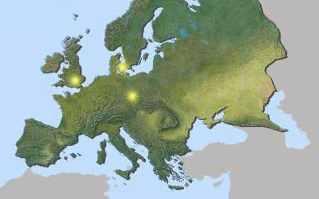
Understanding Europe-
A Cultural Mosaic
By Lila Doma and Liz Grau
Indiana University West European Studies Office

Slide 2
Eastern Europe

Slide 3
Eastern Europe- Rest Stop
Imagine traveling to a country where you could not speak the native language. How would you communicate? Try to communicate a message to the person beside you without talking. It’s difficult. Isn’t it? In Budapest, we found that many people did not speak English, and we could not speak Hungarian. It was VERY DIFFICULT to travel around and also EXTREMELY FRUSTRATING. Think of some suggestions for cities to be more accessible to foreign tourists.

Slide 4
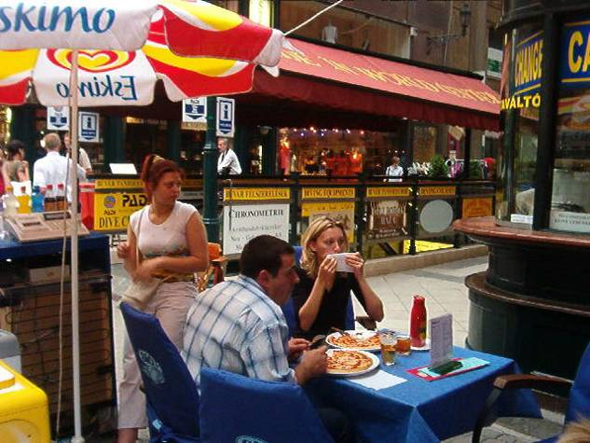
Ketchup on Pizza?

Slide 5
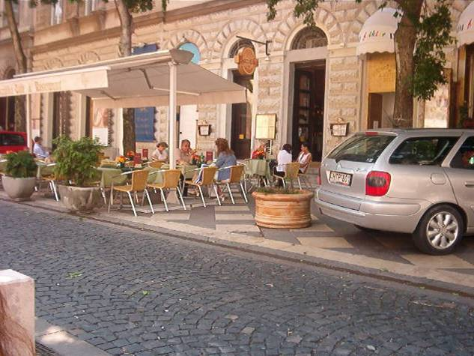
Street Café in Budapest

Slide 6
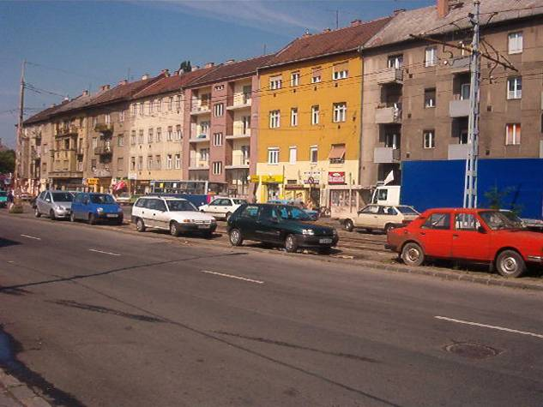
Apartments in Budapest

Slide 7
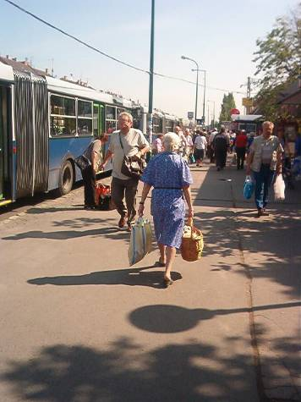
A Woman’s Morning Duty

Slide 8
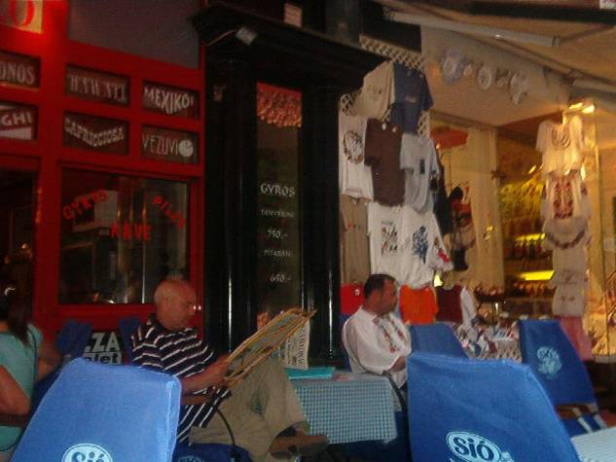
Reading the Newspaper

Slide 9
Eastern Europe- Rest Stop
A little known fact about Budapest….. This capital city of Hungary is actually two cities combined into one name. There is Buda (the Castle district) and Pest (Inner City) separated by the Danube river. In this picture, you can see one of the several bridges that connect the two sides of the city together.

Slide 10
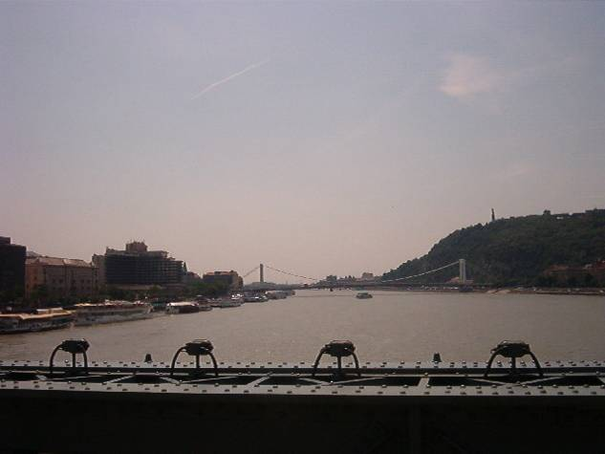
Danube River

Slide 11
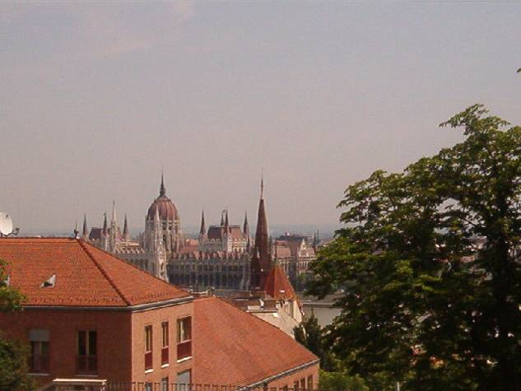
A Rooftop View of Budapest

Slide 12
Eastern Europe- Rest Stop
In the years of war time in Europe, communism began to engulf the country of Hungary. Communism is when the government has total control over the people…and the economy. Hungary began to be effected by this control, and the people became very poor and afraid of the government. In the year 1989, Hungary broke free of its communist government, and to this day is working to improve the economy. Hungary is now a liberal government with a market economy. While visiting it was interesting to see how much progress Hungary has made in less than 20 years of being free from communism. In Budapest, shopping is a major commercial market. Many of the shops are owned by individuals. Hungary seems to be on a quick path to total recovery.

Slide 13
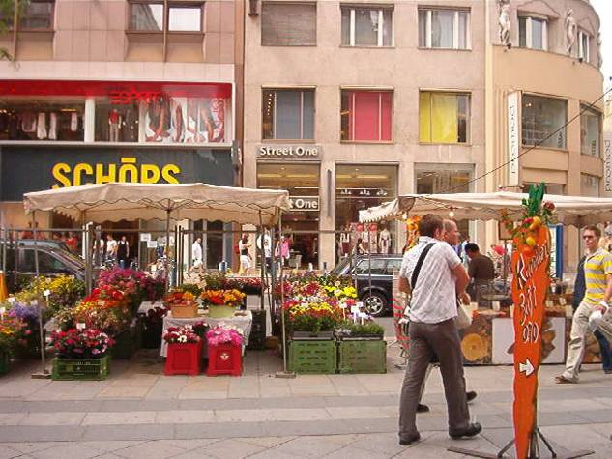
Buying Flowers in Budapest

Slide 14
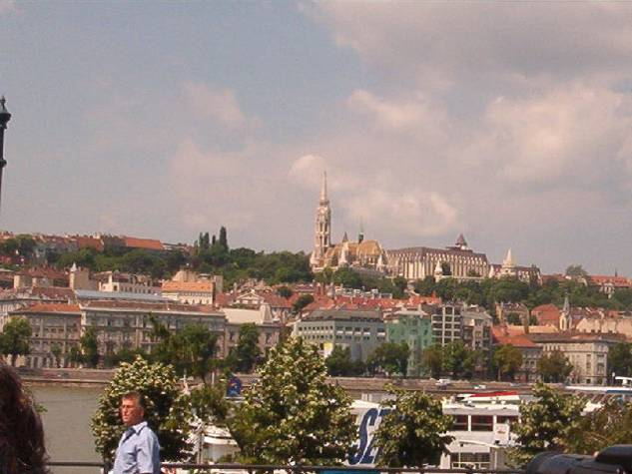
New Government Buildings

Slide 15
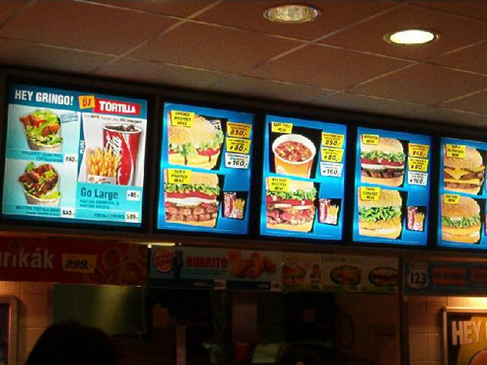
McDonalds in Budapest

Slide 16
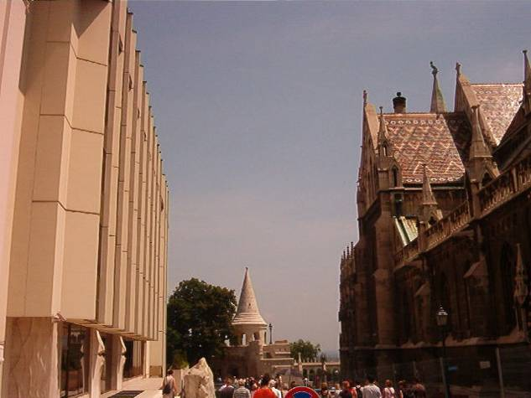
The Old v. the New

