Slide 1
The Euro and the ECB
Economics 2011-2012

Slide 2

Why use the Euro?
Many tourists/citizens use the Euro.
This was not always the case.

Slide 3
Why use the Euro?
What if the US states each had its own currency? Discuss.
Positives of using the Dollar in all 50 States….

Slide 4
Why use the Euro?
Negatives of using the Dollar in all 50 States….

Slide 5

Why use the Euro?
Read pages 10-17 in the article, One Currency for One Europe.

Slide 6
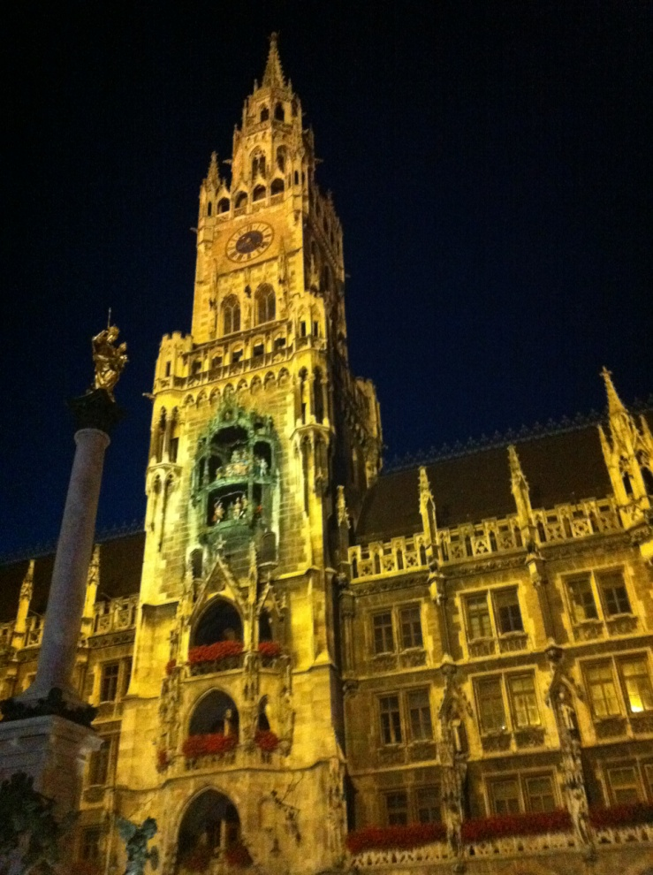
Why use the Euro?
Get in groups and answer the questions on a separate sheet of paper.

Slide 7
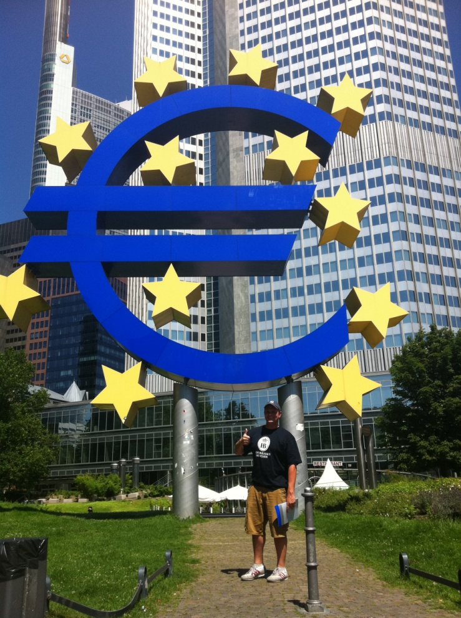
One Currency for One Europe
What is an EMU? Explain.

Slide 8

One Currency for One Europe
What is the ECB and what is its main goal?

Slide 9

One Currency for One Europe
Can any country adopt the Euro?
What must a country gain Euro status?

Slide 10
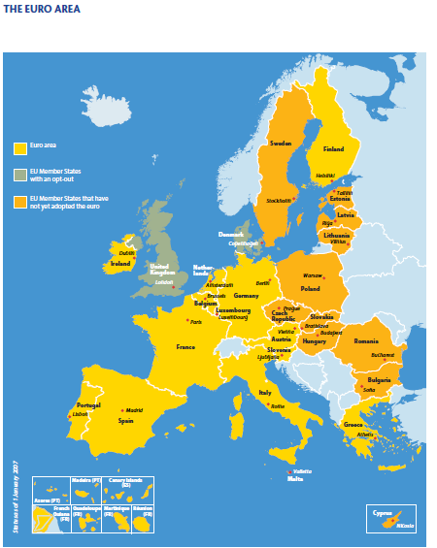
One Currency for One Europe
Since 2002, other countries have adopted the Euro. Explain the two scenarios for adoption.

Slide 11
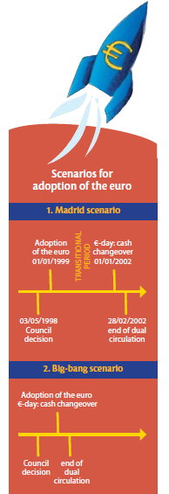
One Currency for One Europe

Slide 12
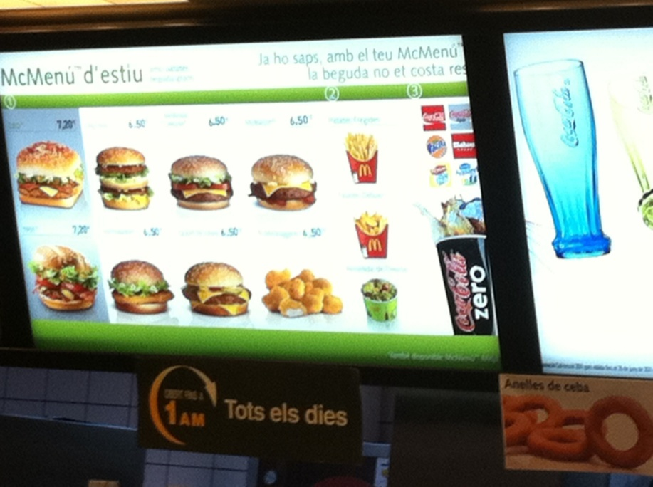
One Currency for One Europe
Explain two reasons why the Euro is good for the consumer.

Slide 13
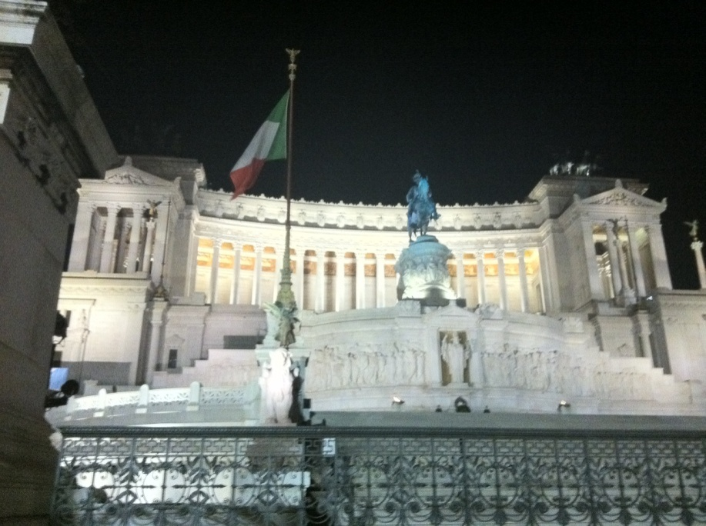
One Currency for One Europe
Explain two reasons why the Euro is good for a nation.

Slide 14
The Euro and the ECB
http://ec.europa.eu/economy_finance/publications/publication6730_en.pdf
Microsoft PowerPoint Clip Art

