Slide 1
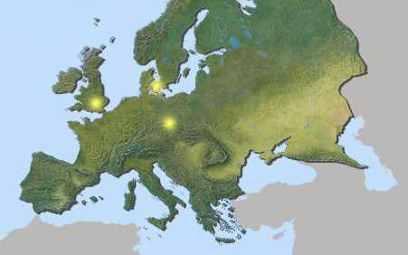
Understanding Europe-
A Cultural Mosaic
By Lila Doma and Liz Grau
Indiana University West European Studies Office

Slide 2
Western Europe

Slide 3
Western Europe- Rest Stop
One beauty that Austria is known for is it’s spectacular rose gardens. There are over 800 types of roses in these gardens. The months to visit these gardens are May through July. There are many events that occur in the rose gardens including weddings, family gatherings, and other celebrations.

Slide 4
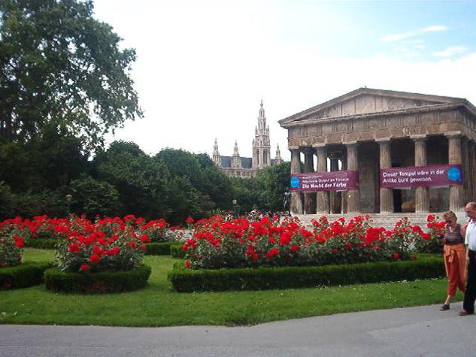
Volkspark

Slide 5
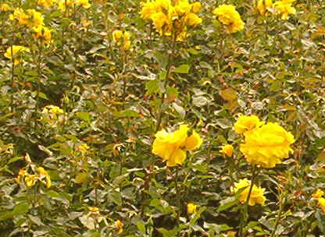
Austrian Roses

Slide 6
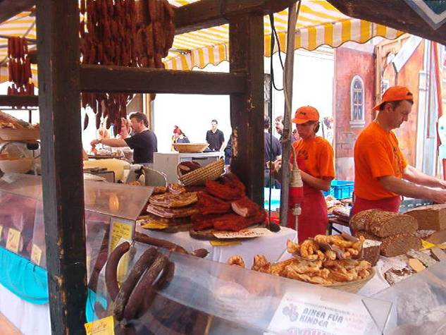
Austrian Open-air Market

Slide 7
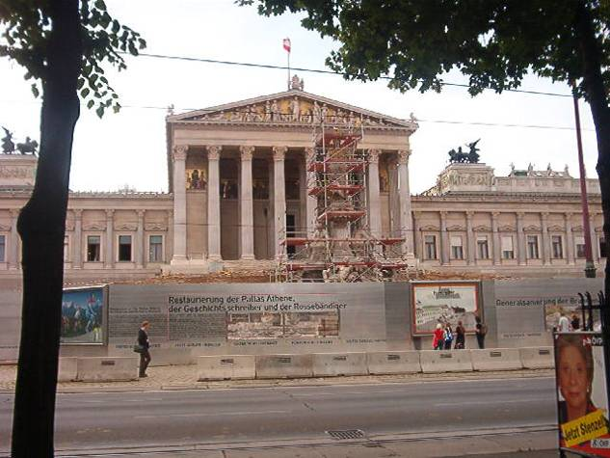
Austrian Parliament

Slide 8
Western Europe- Rest Stop
Vienna has been known for its musical influence across the world, and throughout history. It has been home to Mozart, Beethoven, Schubert, and Strauss. These amazing composers have influenced many musical greats. Today, Vienna houses the Philharmonic orchestra, along with many other musical events.

Slide 9
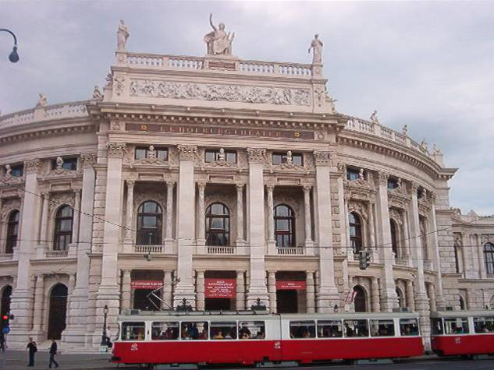
Austrian National Opera house

Slide 10
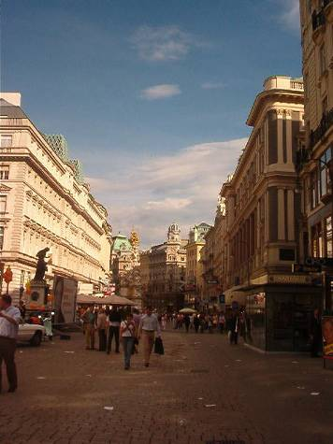
Austrian street

Slide 11
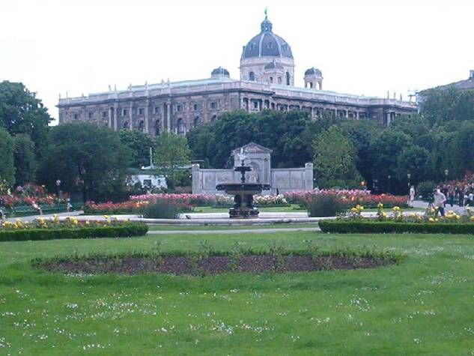
Austrian park

Slide 12
Western Europe- Rest Stop
Physical health and the environment are two very important issues in Western Europe. Citizens of many western European countries believe that these two issues are linked to a happy and zestful life. How does the next picture relate to this philosophy?

Slide 13
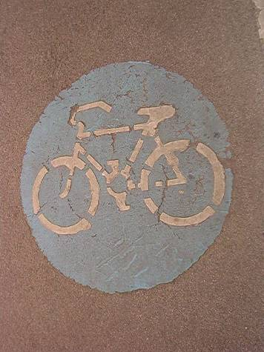
Austrian street lane

Slide 14
Western Europe- Rest Stop
The Eiffel Tower is noted as the most recognized European monument worldwide. The tower was built in remembrance for the French Revolution and greeted visitors to the 1889 World’s Fair in Paris. What are some other famous monuments? What is their significance? What does that say about the countries that built them?

Slide 15
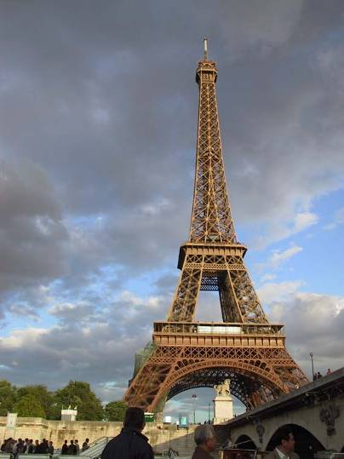
Eiffel Tower

Slide 16
Western Europe- Rest Stop
When England and France decided to connect their two countries with a 32-mile rail tunnel beneath the English Channel, engineers were faced with a huge challenge. Not only would they have to build one of the longest tunnels in the world; they would have to ensure publics safety in a tunnel this size. $21 billion dollars later, the Chunnel has connected over 40 million passengers from France to England and remains to be one of the greatest engineering feats of modern time.

Slide 17
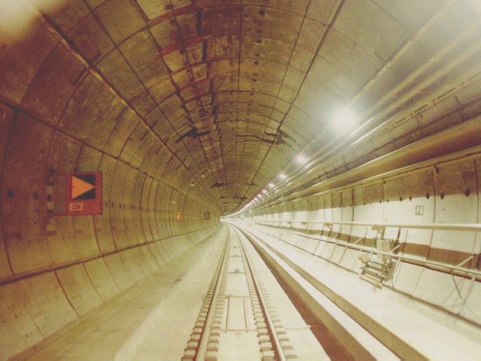
The Chunnel

Slide 18
Western Europe- Rest Stop
Many artists, writers, and other forward-thinkers were lured to Paris in search of academic and artistic freedom during and after World War II. Under the influence of breath-taking views and potent espresso, they managed to create the dramatic tone for the artistic community that dominates Paris today. Can you see why Paris has been such an inspiring city for centuries?

Slide 19
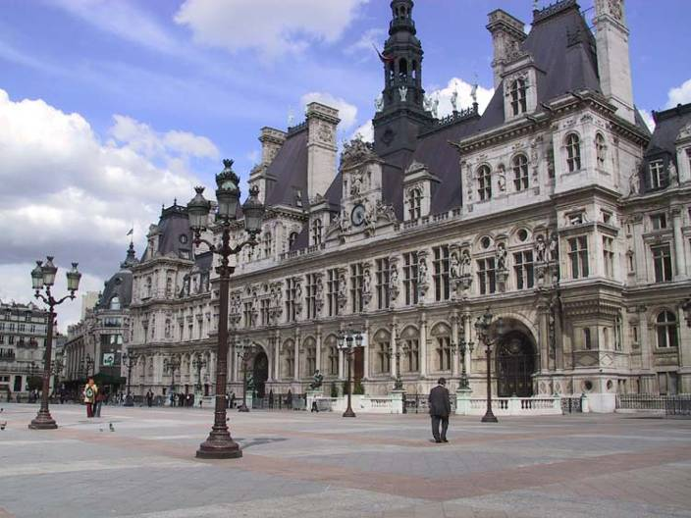
Paris

Slide 20
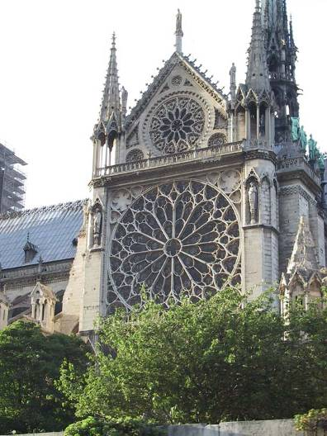
Notre Dame Cathedral

Slide 21
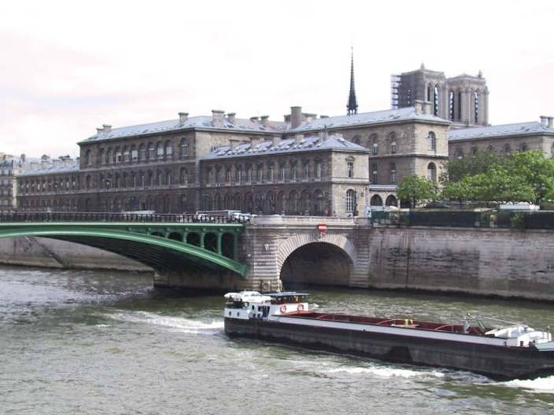
The Seine River

Slide 22
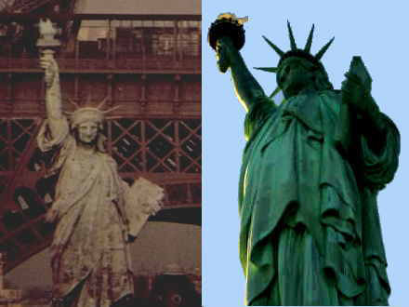
Did you know our Statue of Liberty has a sister?

