Slide 1
Immigration Benefit Or Burden

Slide 2
Immigration Questions
The United States is a country built on immigrants. The objective of this presentation is to look at the next wave of immigration in the United States, England and France. How are immigrants viewed, where do they fit in, what obstacles do they face?
The problems faced in the United States are similar to that in France and England

Slide 3
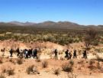
Who is an immigrant?
Somebody who has come to a country and settled there.

Slide 4
How does an immigrant fit in?
 | France | United Kingdom | United States
Current Population | 63,713,926 | 60,776,238 | 301,139,947
Median Age | 39 | 39.6 | 36.6
Population Growth | .588% | .275% | .894%
Life expectancy | 77.35 | 78.8 | 78
Median Income | $31,100 | $31,800 | $44,000
Unemployment Rate | 8.7% | 2.9% | 4.8%

Slide 5
Why do people immigrate?
Be with family members
Seek new economic opportunity
Escape political persecution
Evade religious persecution
Flee from war

Slide 6
2006 Immigration Patterns To The United States
According to Wikipedia:
“There were 1,266,264 immigrants who were granted legal residence in 2006, up from 601,516 in 1987, 849,807 in 2000, and 1,122,373 in 2005. The top twelve sending countries in 2006, by country of birth: Mexico - 173,753, China, People’s Republic - 87,345, Philippines - 74,607, India - 61,369, Cuba - 45,614, Colombia - 43,151, Dominican Republic - 38,069, El Salvador - 31,783, Vietnam - 30,695, Jamaica - 24,976, South Korea - 24,386, Guatemala - 24,146, Other countries - 606,370.[7] In fiscal year 2006, just 202 refugees from Iraq were allowed to resettle in the United States. “
“Those who immigrated between 2000 and 2005, 58% were from Latin America.”

Slide 7
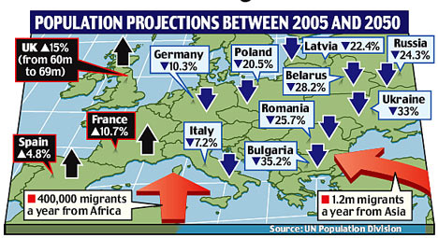
European Migration Pattern

Slide 8
How to Immigrate to France
Apply at the French Consulate in the country where they are a legal resident
Must have financial means
Prove you are not a threat to public order politically or medically

Slide 9
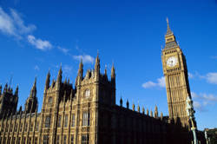
How to Immigrate to England
Apply at the English Consulate in the country where they are a legal resident
Restriction on employment or occupation
Maintain and provide for himself and family members
Register with police
Subject to medical exam

Slide 10
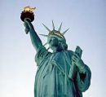
How to the Immigrate United States
Apply at United States Consulate where they are a legal resident
Meet qualifications of the varieties of Green Cards
Medical exam
Police background check

Slide 11
European Union Immigration
Ever since 1957, the Treaty establishing the European Economic Community has contained provisions for ensuring the free movement of workers within the Community
The Amsterdam Treaty, signed in 1997, aims to create an "area of freedom, security and justice" without controls at internal borders for individuals, whatever their nationality.
The Union has established a policy for asylum and immigration.

Slide 12
Positive Impact of Immigrants
Understand the “new” culture
Can speak, read and write the language
Serve in military
Pay into the tax system
Work at low paying jobs
May possess a special trade/skill
Native culture enriches new culture

Slide 13
Negative Impact by Immigrants
Do not understand the culture
Cannot speak, read or write the language
Do not pay taxes
Send money home (out of country)
Drain on health and education system
Take jobs away from native citizens
High crime rate
Viewed as a threat to society

Slide 14
On going problems
Assimilation into Western Society
Racial tension
Religious difference within groups and other religious groups
Borders viewed as porous
Lack of employment opportunities
Terrorism
Drain on countries resources

Slide 15
Government attempts to regulate the flow of immigrants
Great Britain
Create a Border and Immigration Agency
United States
New immigration law – Proposed by President Bush but not passed by Congress
Military on borders
Fence
France
Proposed Office of National Identify

Slide 16
Special Thanks!
Dr. Sylvan Charat, Professor of History and advisor to French National Assembly, Paris, France
Professor Pablo Hernandez – Saint Mary’s College Notre Dame, Indiana
Penn High School Current Issues Classes 2005-2006 & 2006-2007
Yahoo Pictures
Wikipedia

Slide 17
Created by
Tom Van Meter
Social Studies Teacher
Penn High School
56100 Bittersweet Rd
Mishawaka, In 46546

Slide 18
End

