Slide 1
Socratic Seminars: Who? What? When? Where? Why? How?
Lisa Laker, English Teacher
Franklin Central High School
Teacher Leadership Academy #9

Slide 2
“Can I ask you a question?” -Socrates

Slide 3
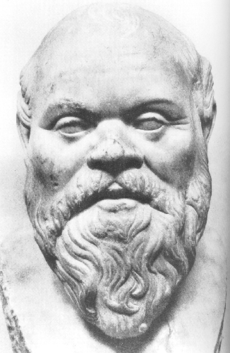
Who was Socrates? (469-399 B.C.)
Considered greatest philosopher of all time
Lived during the height of Greek culture
Searched for truth and meaning of life through questioning
Teacher of Plato

Slide 4
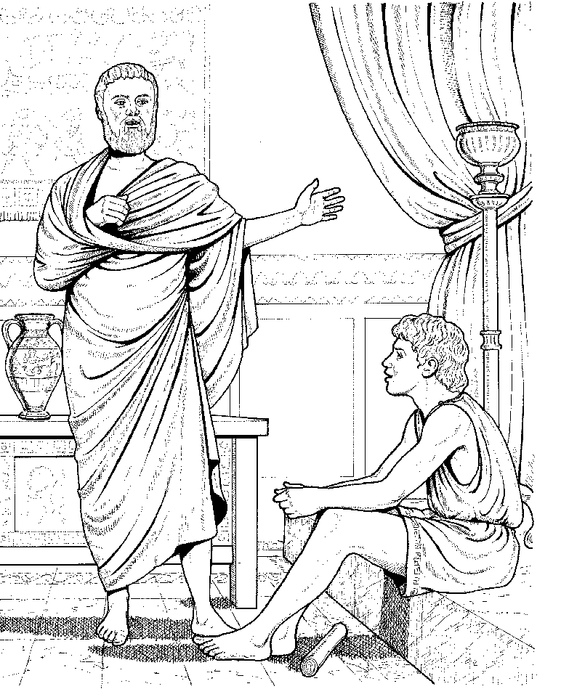
Socrates continued

Slide 5
What is a Socratic Seminar? “… a motivating form of scholarly discourse based on the ‘essential question.’” (www.ncsu.edu/literacyjunction/html/tutorialsocratic.html)

Slide 6
A Socratic Seminar consists of four elements:
The text: Can come from any subject area
The question: Reflects genuine curiosity and has no “right” answer
The leader: offers the initial question and serves as a facilitator of the seminar
(www.ncsu.edu/literacyjunction/html/tutorialsocratic.html)
The participants: study the text in advance, listen actively, and share ideas using evidence from the text for support

Slide 7
Why use Socratic Seminar?
To develop higher order thinking skills
To teach big concepts
To encourage questioning and reflection
To foster self-discovery

Slide 8
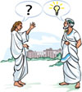
Socrates believed it was very important for students to question the world around them. It was then that true learning took place.

Slide 9
Where? Basically, anywhere your group can form a circle.
Classrooms: in desks or on the floor
Auditorium stage
Cafeteria
Outside: on the football field or by the school pond
Gymnasium

Slide 10
When?
Beginning of unit…
Middle of unit…
End of unit…
Emotional hook Provides focus
Clarifies preconceived ideas and misconceptions
Solidifies “big picture” Makes connections Closure or Segway

Slide 11
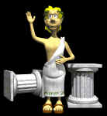
Enough already… wanna’ get started?
But How?

Slide 12
Procedures
Teacher must kick off unit by assigning text, show art, etc.
Teacher explains Socratic Method and student responsibilities.
Students form a circle.
Teacher asks thought-provoking question and student discussion commences.

Slide 13
?The Essential Question?
Points to the heart of the topic and its controversies.
Generates multiple answers and perspectives.
Uncoverage vs. Coverage.
Encourages deeper interest in the subject.

Slide 14
Socratic Rules
Respect all participants.
Be honest and concrete with your opinion.
Allow speaker to complete thought w/out interruption.
Be an active listener.
Usurping discussion time is deemed most unsocratic!

Slide 15
Students are responsible for:
the flow of the discussion within the seminar.
constructing own analysis of the seminar.
utilizing critical thinking, active listening, and communication skills.

Slide 16
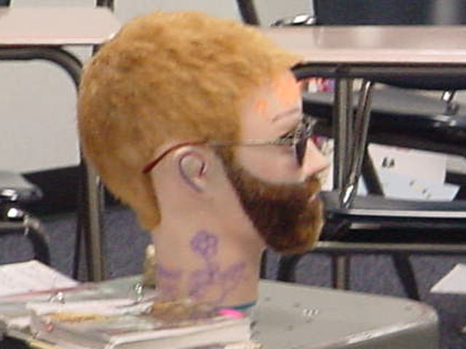
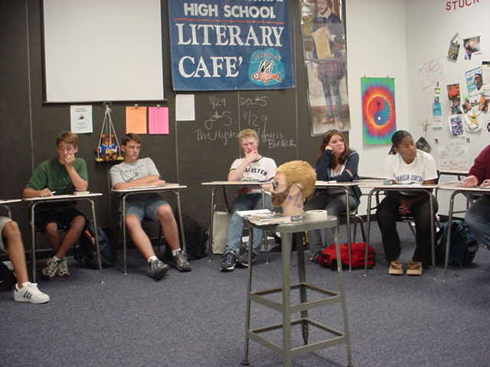
Demonstration What does it look like?

Slide 17
….Let’s try it out together

Slide 18
The Key: Follow-up Reflection
Journal: Tally Sheet, etc.
Self-Assessment Narratives
Authentic Projects

Slide 19
Spin-Offs:
Inner/outer circles
A/B chain
Talking chips
Brain lights
Toilet paper

Slide 20
Accountability
Example Rubric
Number of Comments/Questions/Quotes
Excellent Good Okay None
Quality of Comments
Excellent Good Okay None
Text References (if applicable)
Excellent Good Okay None
Listens to others/asks/answers questions
Excellent Good Okay None

Slide 21
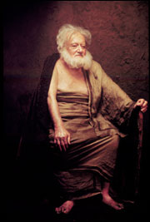
Special Note:
Inappropriate comments during the seminar will result in an “F” for this seminar.
Such statements like, “That is stupid!” or “Who cares what you think!” are unacceptable.
Violators will be forced to recant Plato’s Republic for the class or take this old dude to the prom!

Slide 22
Resources
Assigned texts within content area
Socrates Café by Christopher Phillips
Internet
Lisa.Laker@ftcsc.k12.in.us

Slide 23
Works Cited
Debbie Fish, TLA Coordinator Dfish@CIESC.k12.in.us
www.ncsu.edu/literacyjunction/html/tutorialsocratic.html
Phillips, Christopher. Socrates Café. W.W. Norton and Company, Inc. New York: 2000

Slide 24
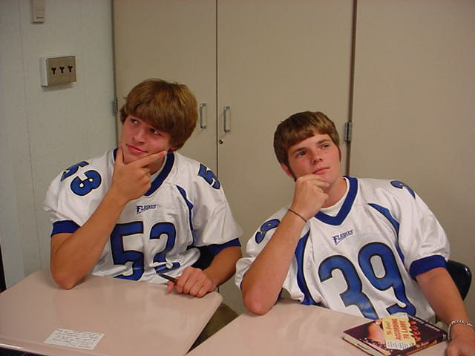
Things to Ponder

Slide 25
Ponder These Questions:
Who?
What? When?
Where?
Why? Because Socrates would be proud,
and so would I! How?

Slide 26
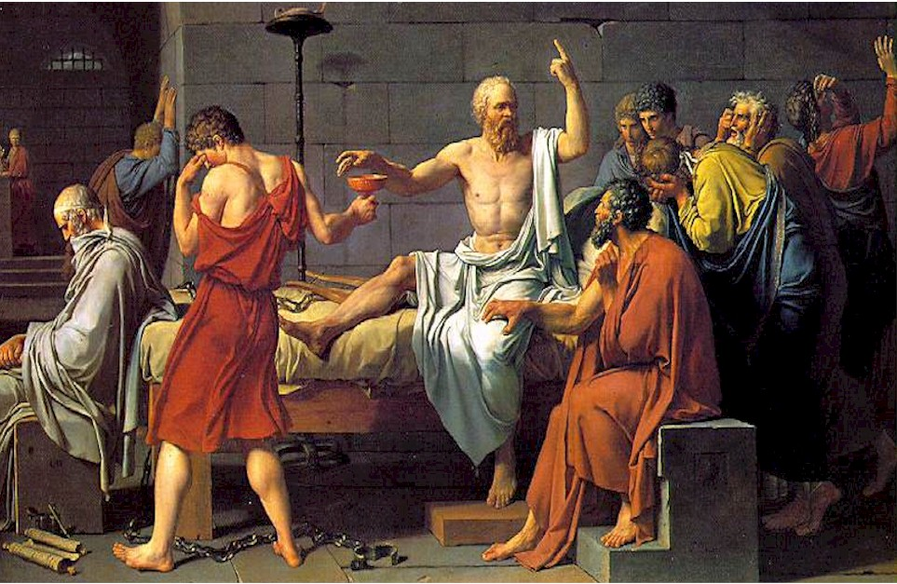
Final Question: Will Socratic Seminar make a difference in your learning?

